Slide 1


Team 26: Voice-Controlled Robot
Bi-Weekly Update 5 Logan Cardwell, Dawson Holly,
Nicholas McCray, Cameron Schoenfeld Sponsor: Zhewen Hu TA: Zhewen Hu
Notes:
Logan

Slide 2
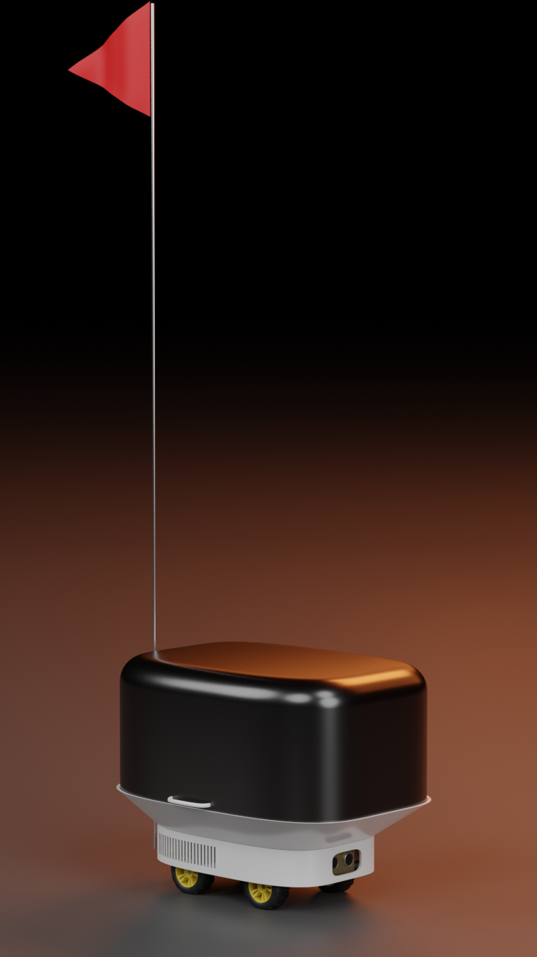
Project Summary
The restaurant industry can be streamlined with the inclusion of automated service robots to deliver food directly to the customer without the need of human waitstaff.
The robot is able to take in voice commands and manual control from a mobile application to direct its movement while sensors detect and prevent imminent collisions. Additionally, the robot will be able to navigate through a predetermined map of the environment to quickly navigate to any marked location.

Slide 3
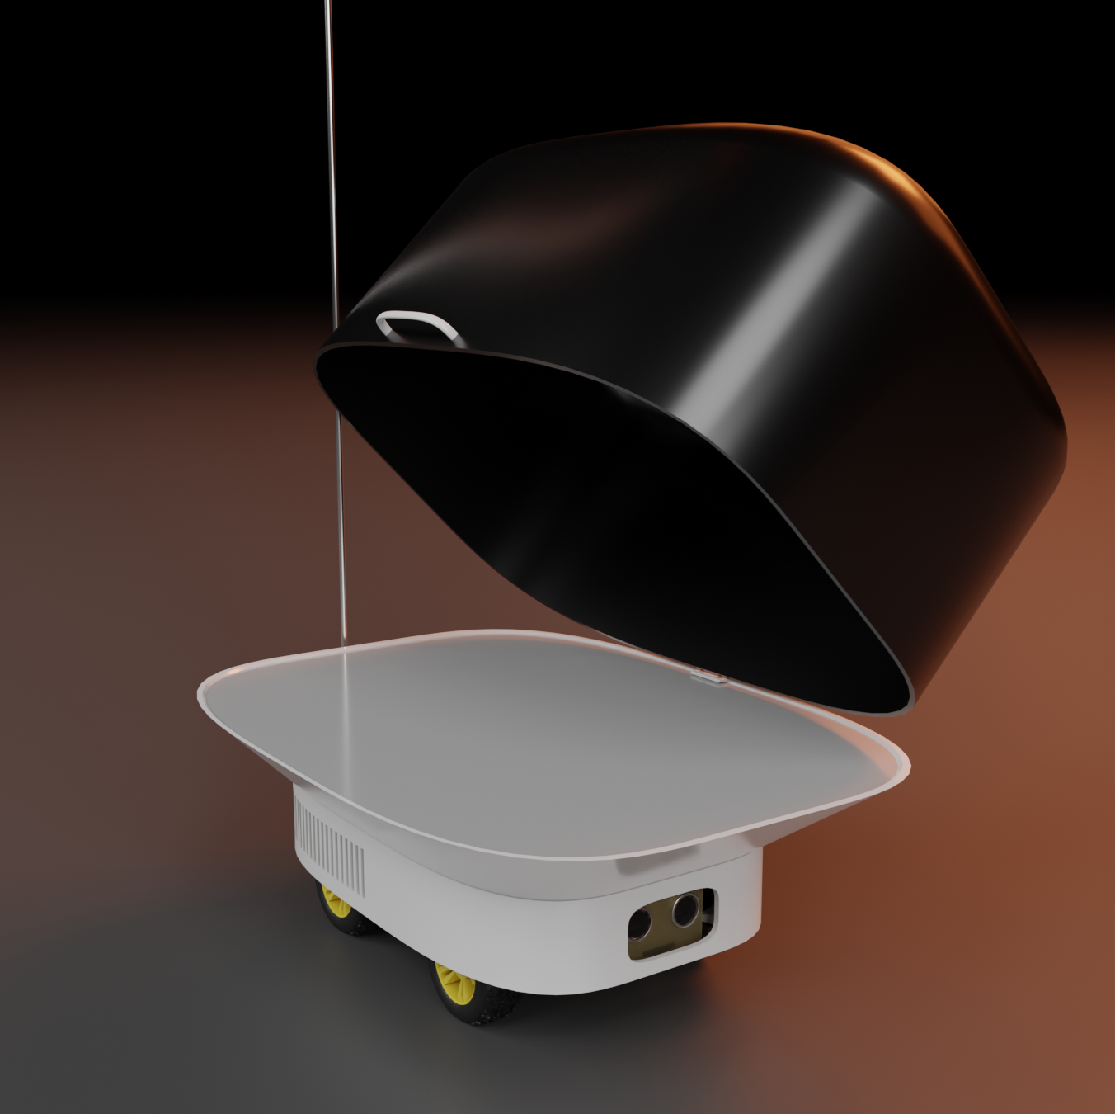
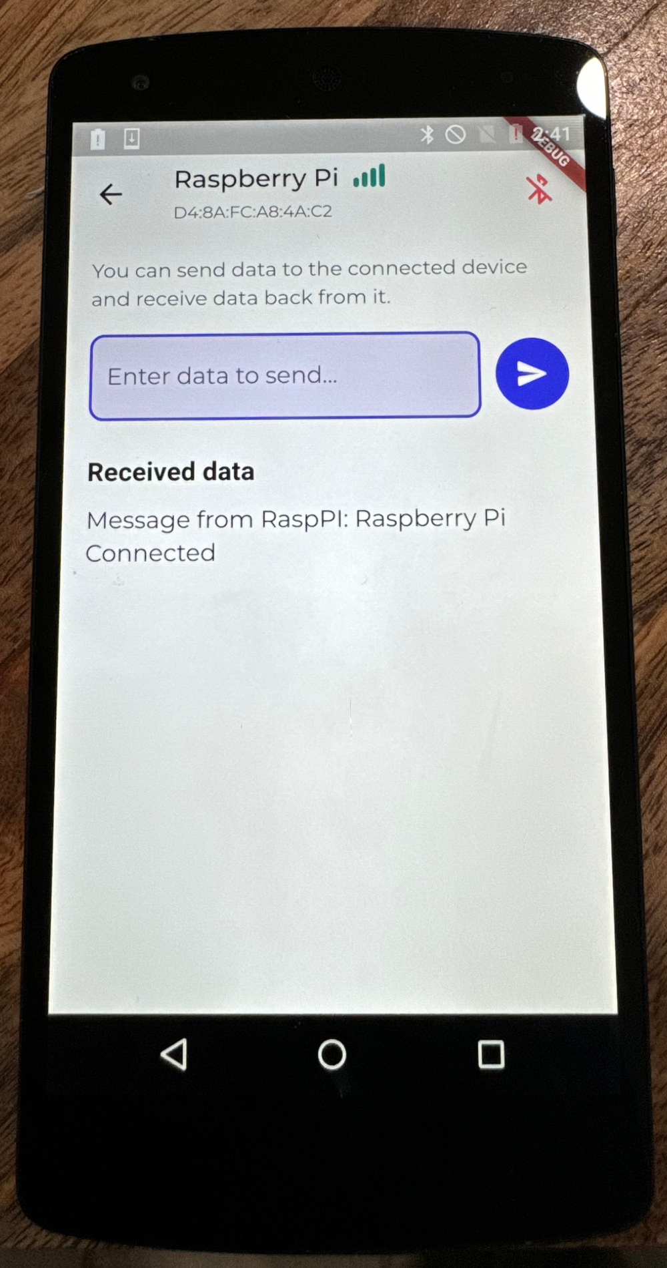
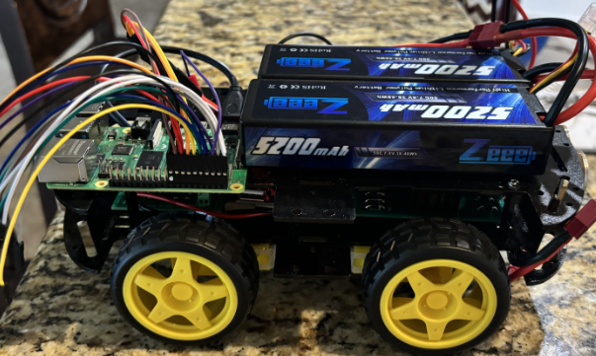
Integrated System Diagram
Body design to protect the robot from food spills and general damage.
Manual control signal / audio file transmission to give robot instructions via Bluetooth.
Feedback to app when instructions are completed or when obstacles are encountered.
Pathfinding to specified locations with collision avoidance.

Slide 4
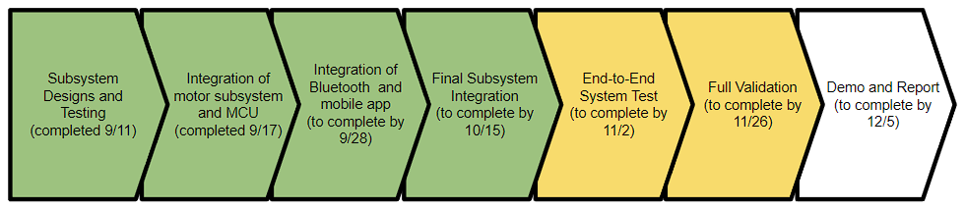
Project Timeline

Slide 5
Logan Cardwell
Accomplishments since last update 13 hrs of effort | Ongoing progress/problems and plans until the next presentation
The test body was printed and the fit was confirmed. Various adjustments were made to strengthen the frame, and it’s connection points and the rest of the robot body was printed. The STT system was successfully integrated with the main code of the robot. | The body will be sanded, bondo will be applied to fill the seams, and the body will receive its final white paint job with a protective clear coat. Slack will be picked up on whatever help Cameron and Nick need.

Slide 6
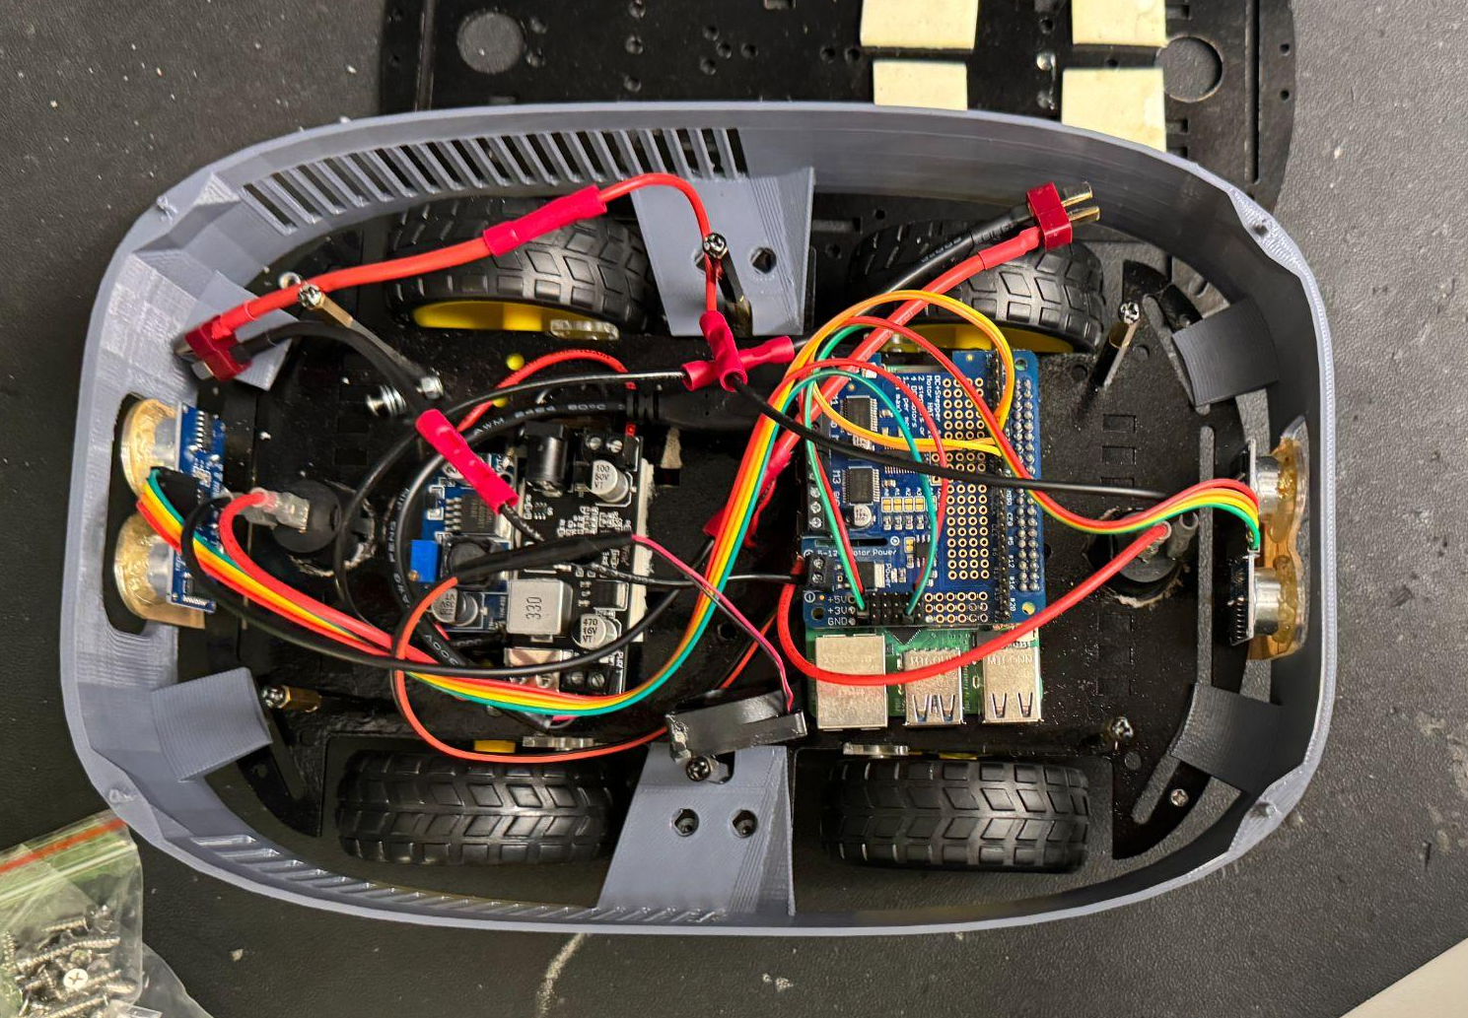
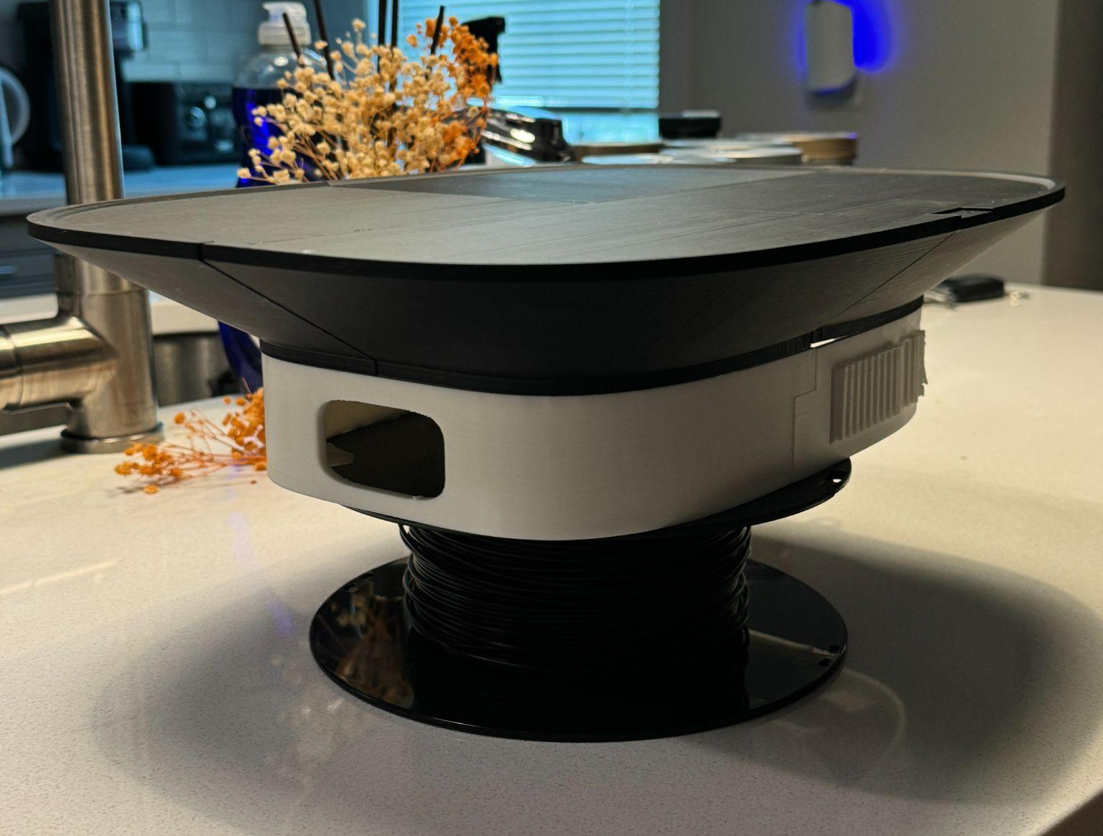
Logan Cardwell
The measurements made last week and the week before were accurate. All holes lined up properly although the peg attachment points easily snapped.
The final print has different connection points than the test version, the walls were thickened to make the frame less flimsy, and the model resolution was increased.

Slide 7
Dawson Holly
Accomplishments since last update 10 hrs of effort | Ongoing progress/problems and plans until the next presentation
Mounted both power switches. All frame components are completed. Fan is mounted. All wires mounted and secured. PCB’s are secured. Proper temperature regulation. Sensors have been mounted and wired. Loose connections have been soldered for durability. | Integrate with app. Add remainder of shell body to frame chassis. Complete final integration.

Slide 8
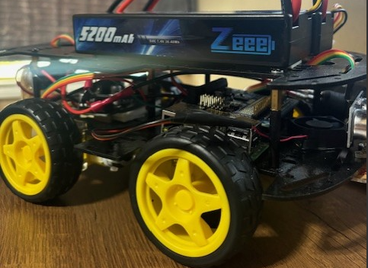
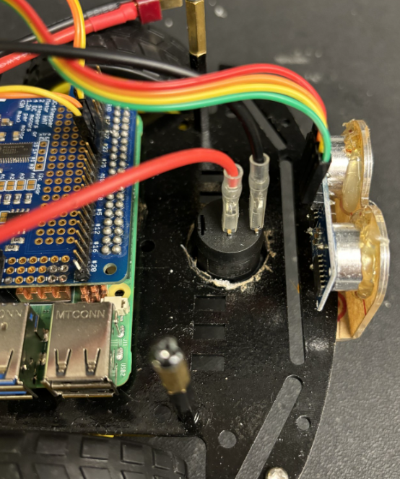
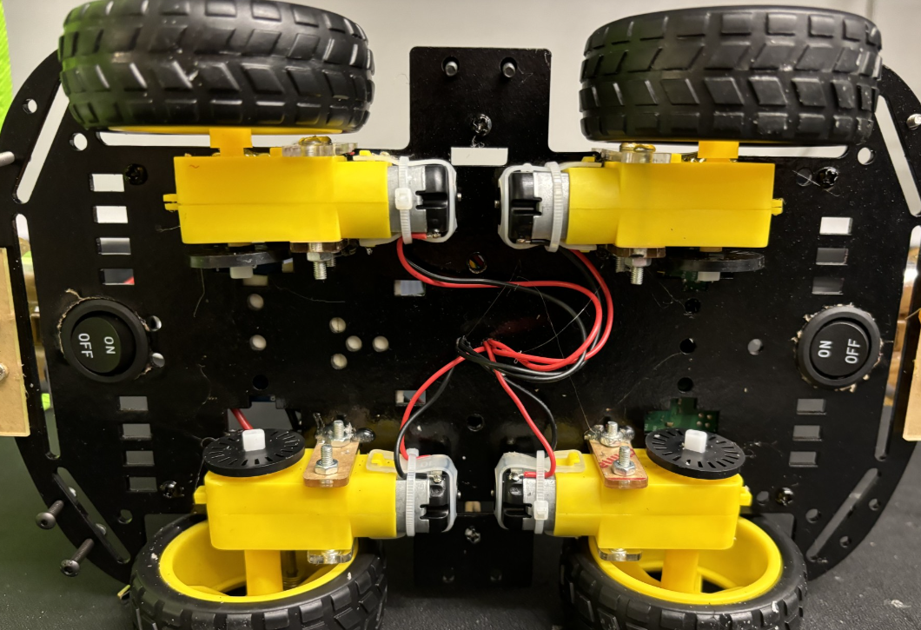
Dawson Holly

Slide 9
Nicholas McCray
Accomplishments since last update 14 hrs of effort | Ongoing progress/problems and plans until the next presentation
Completed manual control signals sent to BLE to control motors. | Complete integration with voice files. Refine GUI.

Slide 10
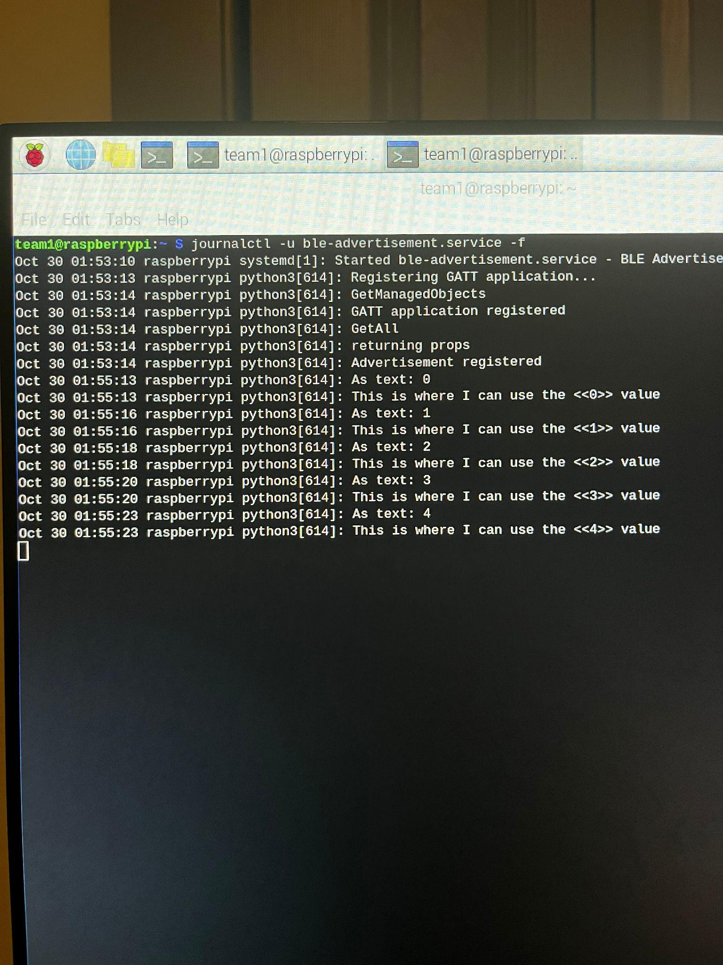
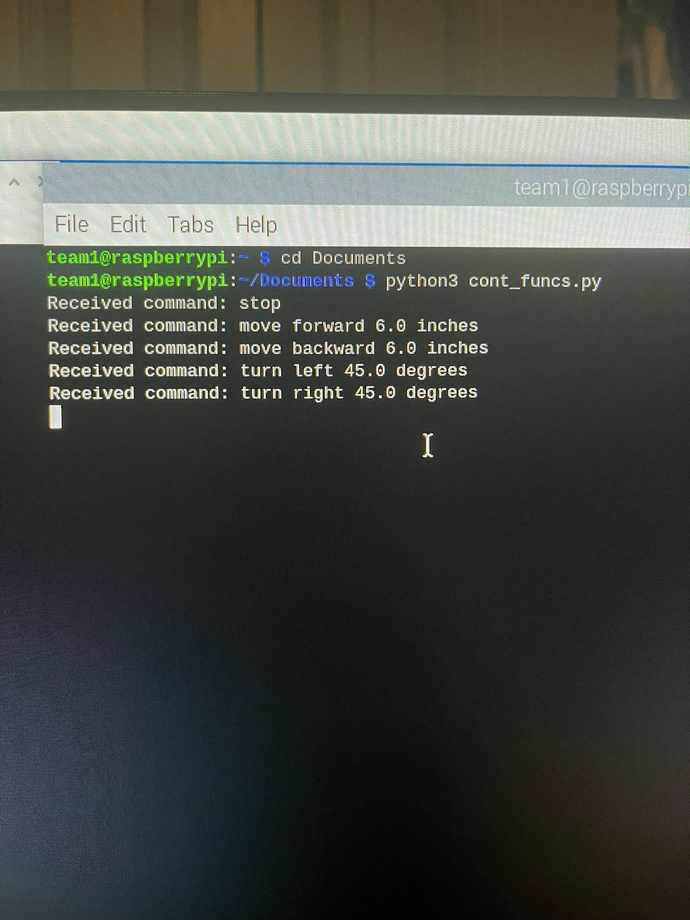
Nicholas McCray
Testing signals between app and motor controls.
When button is pressed, gives value 0-4.
Embedded Systems takes in values 0-4 and sends signals to the motors accordingly.

Slide 11
Cameron Schoenfeld
Accomplishments since last update 8 hrs of effort | Ongoing progress/problems and plans until the next presentation
Successful integration with Voice Recognition. Partial integration with App. Validated correct signal Transmission and Receiving between App and Raspberry Pi. Manual control working and validated. | Complete integration with App. Validate movement distance and sensor signals.

Slide 12
Cameron Schoenfeld
Embedded Systems
Voice to Text (VTT)
Send Audio File
Receive Audio from App
Receive Text String
Movement Commands from Text
Audio file can be transferred from Embedded Systems to the Voice to Text program.
VTT can translate audio file to parsable text string and return to Embedded Systems.
Text can be interpreted to movement functions.
Currently Working on receiving audio file from App via Wifi.

Slide 13
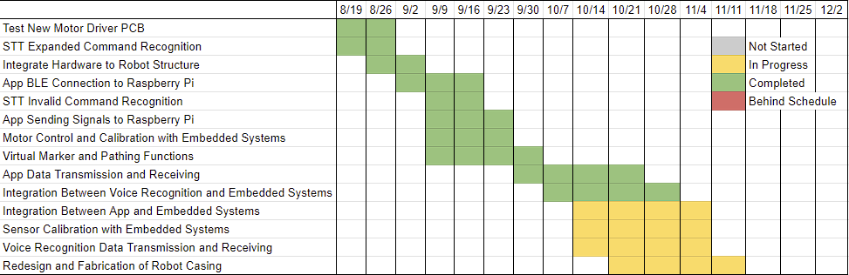
Execution Plan
Notes:
Michelle

Slide 14
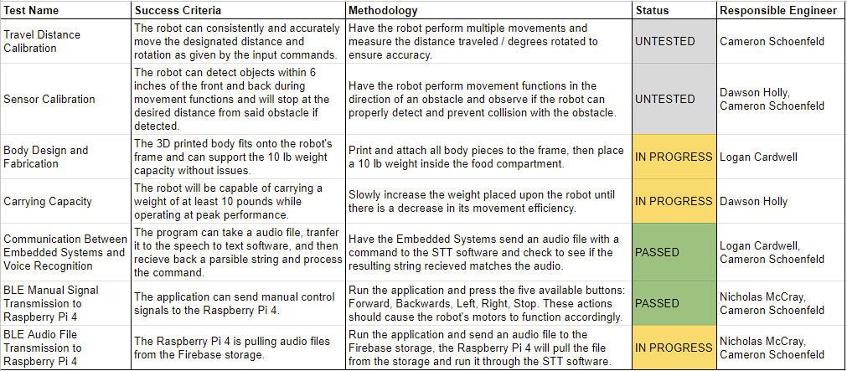
System Validation Plan
Notes:
Michelle

Slide 15
Thank You
Any Questions?

